Slide 1

Overview of the Libra code
Department of Chemistry, University at Buffalo, The State University of New York, Buffalo, NY 14260-3000
Alexey Akimov
“Excited States and Nonadiabatic Dynamics CyberTraining Workshop”
June 14, 2021

Slide 2

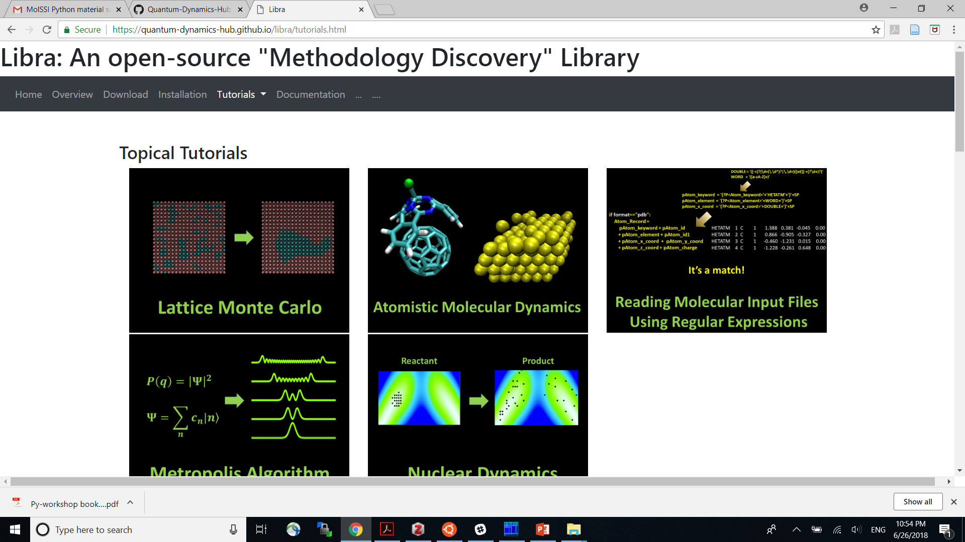
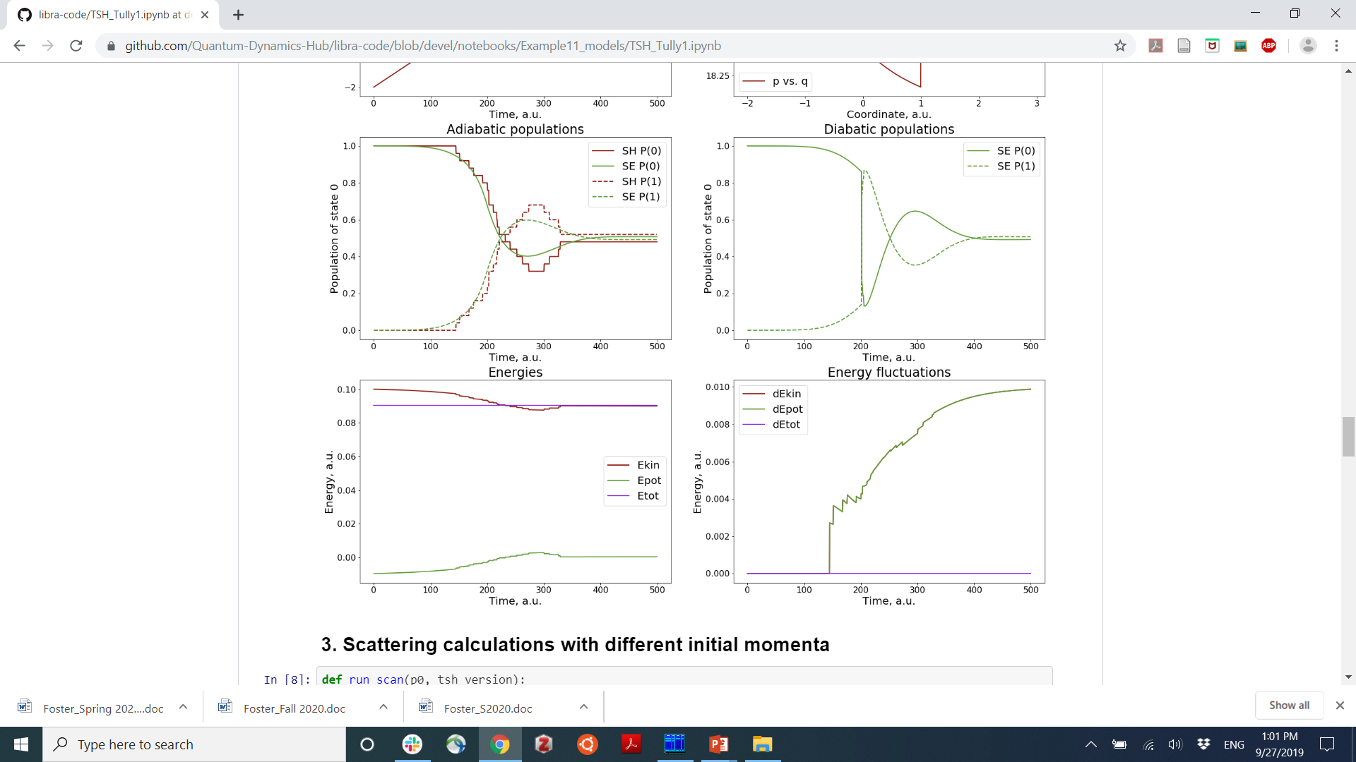
Libra
Alexey Akimov
Akimov JCC, 2016, 37, 1626
Pradhan et al. JPCM, 2018, 30, 484002
https://github.com/Quantum-Dynamics-Hub/libra-code
Sato et al. PCCP, 2018, 20, 25275.
Focus on understanding/assessing methods – methodology prototyping
A range of methods: fully quantum (grid), TSH, Ehrenfest, wavepackets, decoherence schemes, individual vs. coupled trajectories, etc.
Thin boundary between C++ and Python, high modularity, model problems database,
Applications: molecular, condensed matter, NBRA and beyond, model and atomistic
Interfaces with: QE, ErgoSCF, DFTB+, GAMESS, Gaussian, built-in ES
Additional functionality: versatile analysis and auxiliary tools
Languages: C++, Python
Code documentation: extensive
Tutorials and user documentation: extensive
Testing: some
License: GNU GPL 3.0
Numerous Tutorials and Examples (e.g. Jupyter Notebooks)
Forum https://groups.google.com/forum/#!forum/quantum-dynamics-hub
MolSSI workshop materials

Slide 3
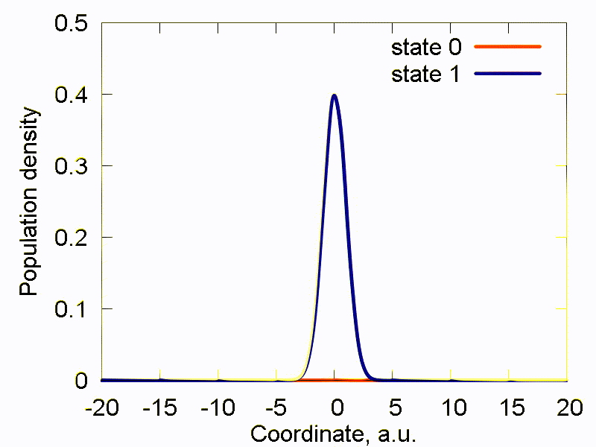
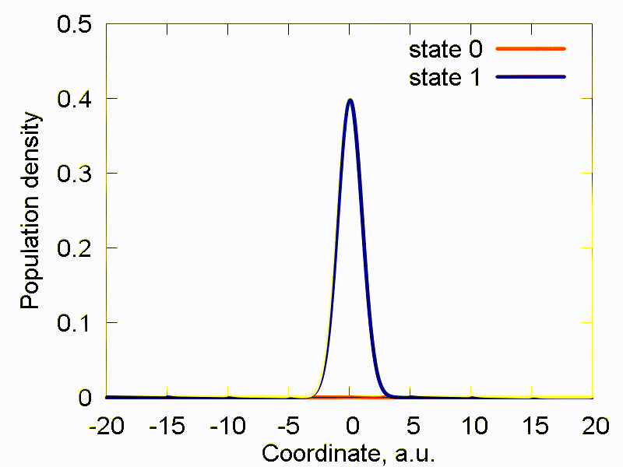
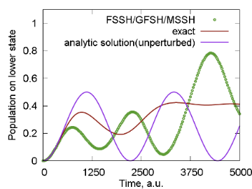
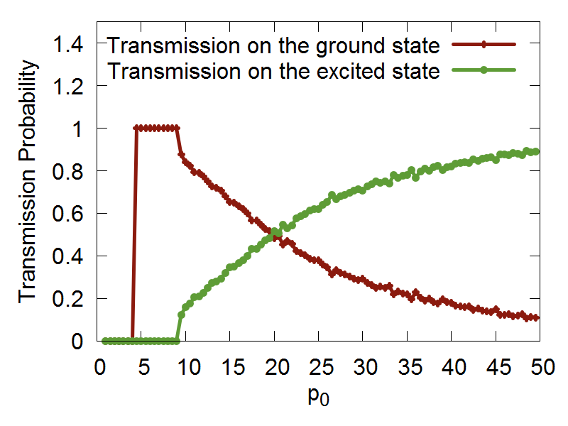
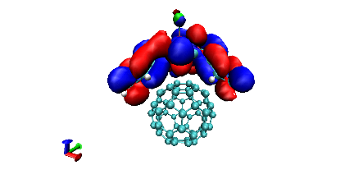
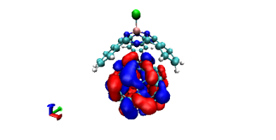
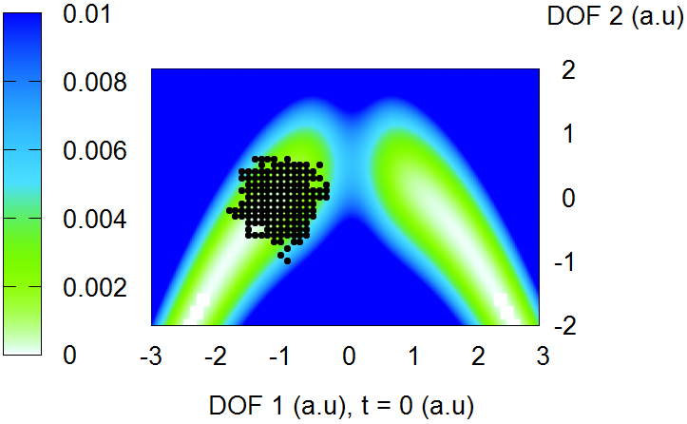
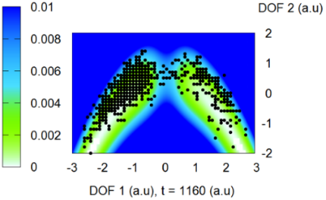
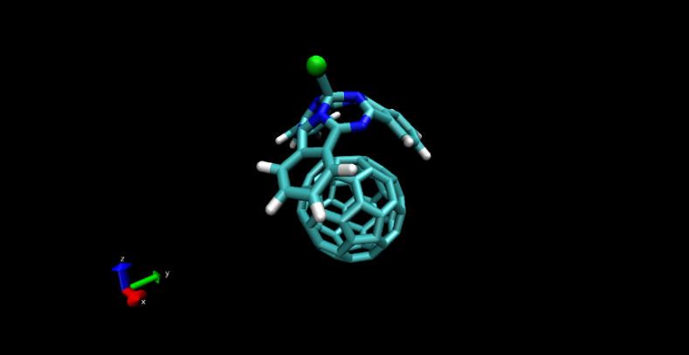
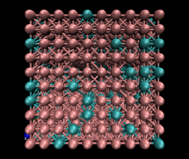
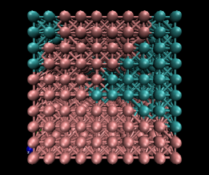
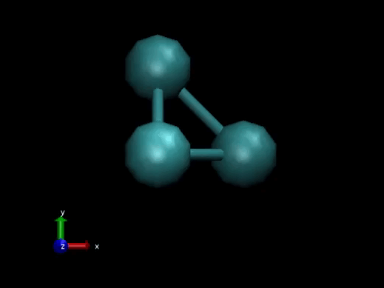
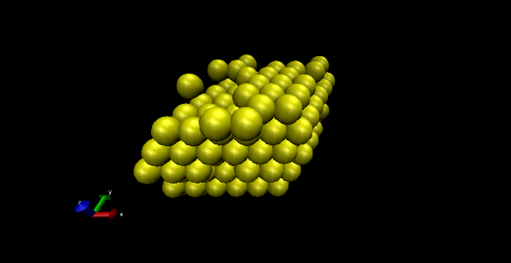
Libra philosophy
modular
Maximize and simplify the re-use, OOP
A variety of methods
versatile
Exact TD-SE integration
Ehrenfest & TSH methods
TSH with atomistic systems
Entangled trajectories methods
Lattice Monte Carlo
Rigid body
Classical MD
“methodology prototyping”
Use with model problems and atomistic simulations
Python – for convenience, C++ - for efficiency
Notes:
So that is what Libra is essentially about..
To give you a more practical idea of how these design principles are implemented, lets discuss several modules..

Slide 4
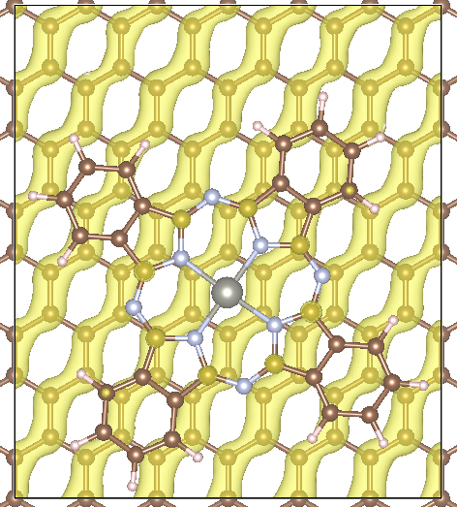
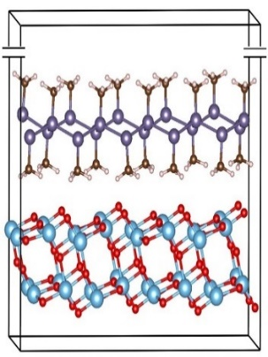
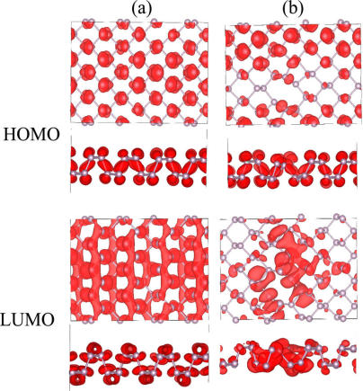
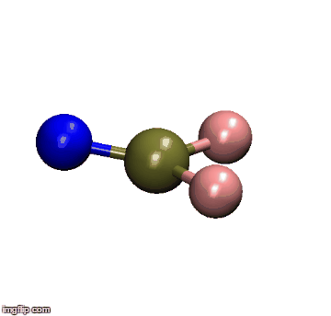
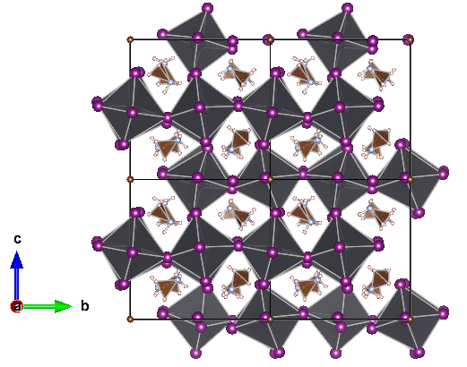
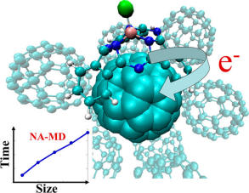
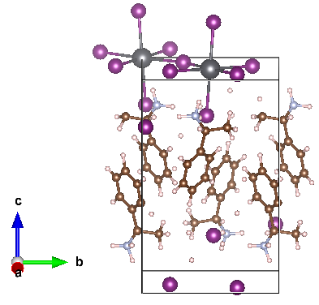
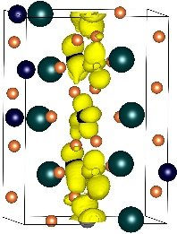
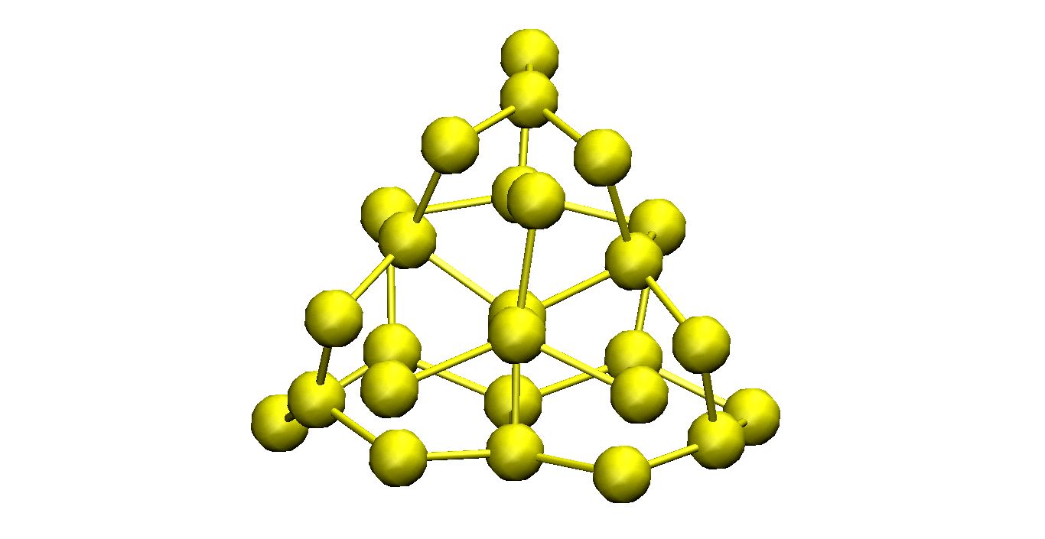
Libra & Pyxaid for Energy Materials
2D systems
2D heterojunctions
Long el al. JPCL 2016, 7, 653.
Nijamudheen, A.; AVA JPCC, 2017, 121, 6520
Organic heterojunctions
Perovskites
Quantum Dots & Molecules
Nijamudheen, A.; AVA JPCL 2018, 9, 248
Lin, Y.; AVA JPCA. 2016, 120, 9028
Sato et al. PCCP, 2018, 20, 25275.
Pradhan et al. JPCM, 2018, 30, 484002

Slide 5


C++/Python Interoperability
C++ layer
Python layer
User-Customized & Library
Python functions
Call by C++
Eigen 3
libra_py
Prototype and
Test (Discover)
Translate code
Use in C++ codes
Use in Python codes

Slide 6
API Diversity
The goal is to suite the use cases at various levels of complexity
Find a balance between simplicity and flexibility
Mix of function-oriented and object-oriented functionality
Developer/Efficiency
double gaussian_overlap( AO* AOa, AO* AOb,int is_normalize, int is_derivs, VECTOR& dIdA, VECTOR& dIdB, vector<double*>& auxd,int n_aux);
double gaussian_overlap( AO* AOa, AO* AOb,int is_normalize, int is_derivs, VECTOR& dIdA, VECTOR& dIdB );
double gaussian_overlap(AO* AOa, AO* AOb,int is_normalize);
double gaussian_overlap(AO* AOa, AO* AOb);
User/Convenience
Computing kinetic energy between Gaussians
Benchmarked against PyQuante
g1 = PrimitiveG()
g2 = PrimitiveG()
g1.init(n1,m1,k1, a1, VECTOR(x1, y1, z1))
g2.init(n2,m2,k2, a2, VECTOR(x2, y2, z1))
kin = kinetic_integral(g1,g2)
p1 = PyQuante.PGBF.PGBF(a1,(R1.x,R1.y,R1.z),(n1,m1,k1))
p2 = PyQuante.PGBF.PGBF(a2,(R2.x,R2.y,R2.z),(n2,m2,k2))
val_ref = p1.kinetic(p2)

Slide 7

Passing Python functions
C++
Python
Models
Implementation
Interface

Slide 8
Example: sampling
vector<MATRIX> metropolis_gau
(Random& rnd,
bp::object target_distribution,
MATRIX& dof,
bp::object distribution_params,
int sample_size, int start_sampling,
double gau_var){
Metropolis Algorithm
double p_old =
bp::extract<double>( target_distribution(s_old, distribution_params) );
…
}
def test():
q = MATRIX(ndof, 1)
output = metropolis_gau( piab, q, params, ...)
User calls the sampling
Output
def piab(q, params):
User defines the
probability density
C++
Python

Slide 9
Example
q = MATRIX(1,1); q.set(0, 0.5)
params = {"k":1.0, "m":2000.0, "states":[0], "coeffs":[1.0]}
Nsamp = 1000000; Nstart = 50000
sampling = metropolis_gau(rnd, HO_sup, q, params, Nsamp,Nstart, 0.05)
bin(sampling, -1.5, 2.0, 0.01, 0, 0, "_distrib-1.txt")
User defines how to
run the MC sampling
(Interface)
def HO_sup(q, params):
k = params["k"]; m = params["m"];
states = params["states"]; coeffs = params["coeffs"]
x = q.get(0)
sz = len(states)
p = 0.0
for n in xrange(sz):
p = p + coeffs[n] * ket_n(x, states[n], k, m)
p = p * p
return p
User defines what
probability distribution
function is to be sampled
(Model)
The dynamical algorithm is in C++, but…
Don’t need to implement the model in C++

Slide 10
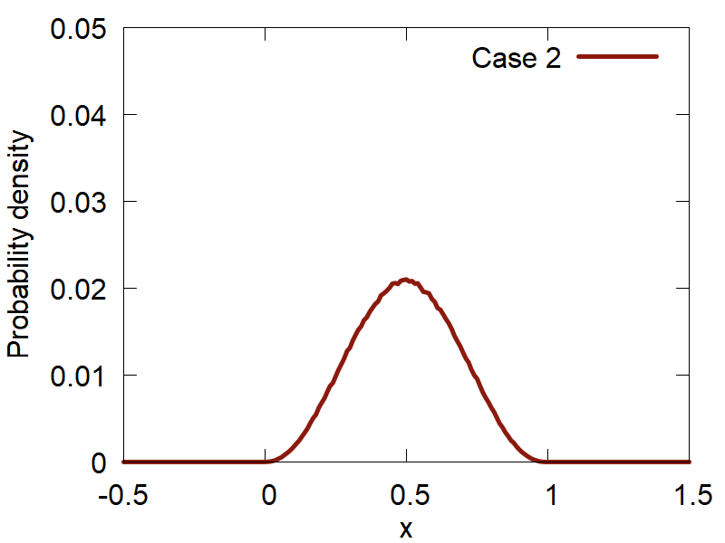
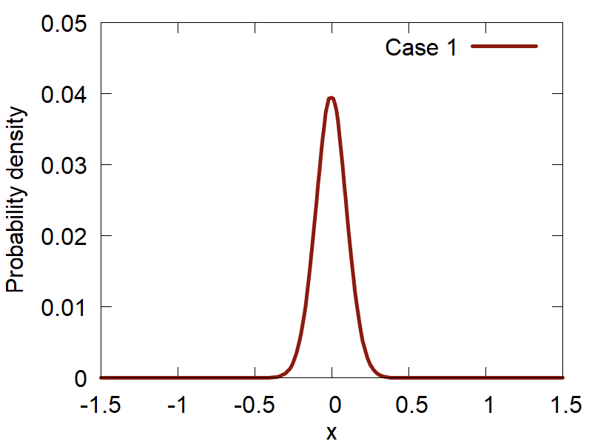
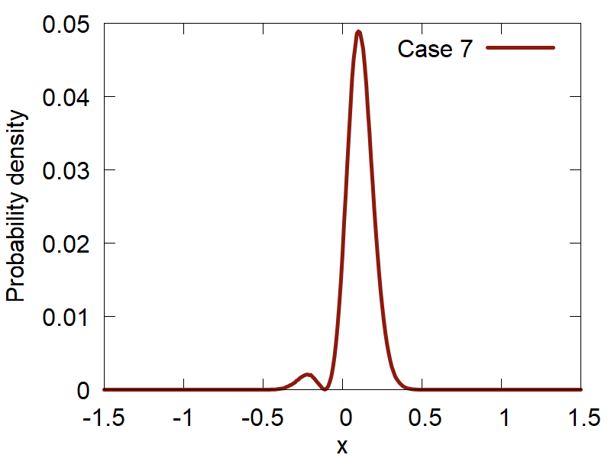
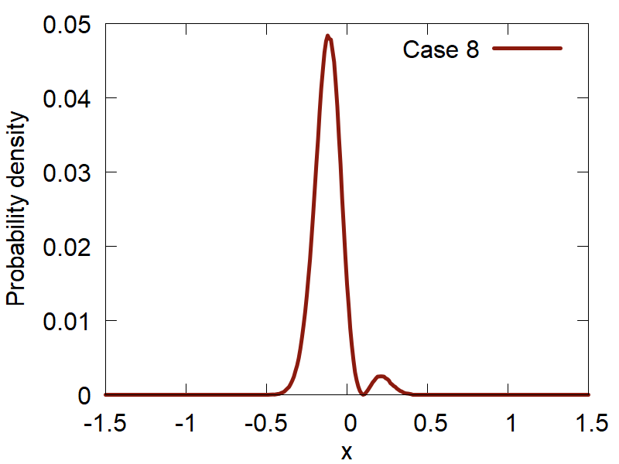
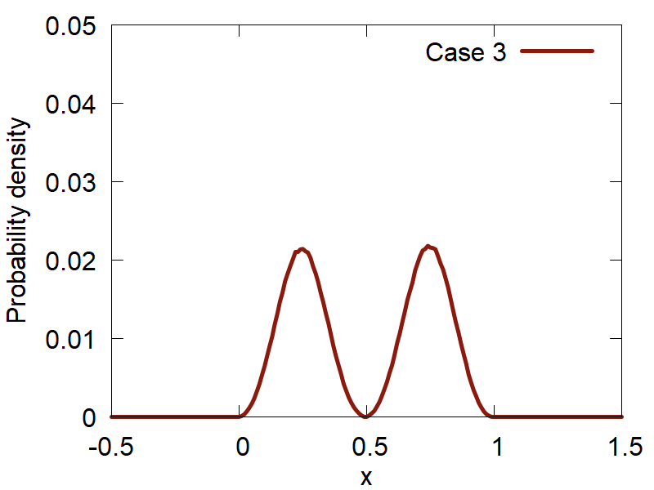
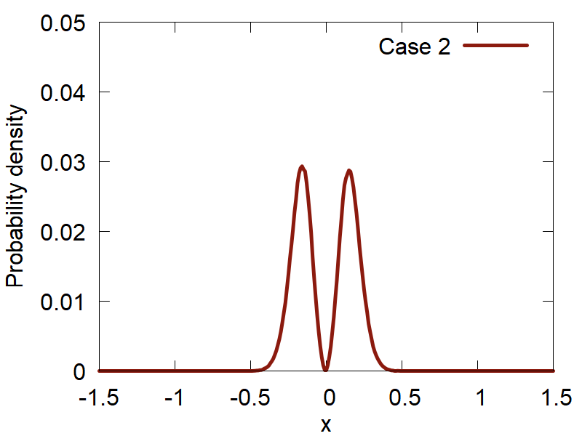
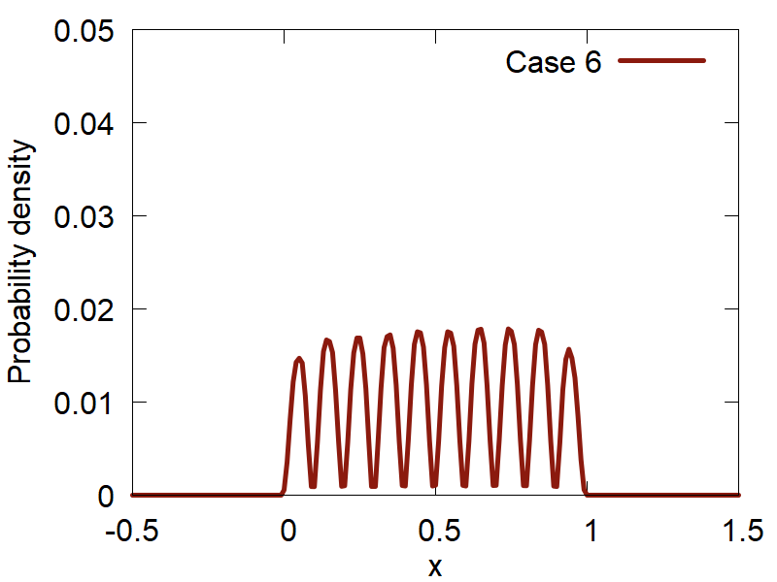
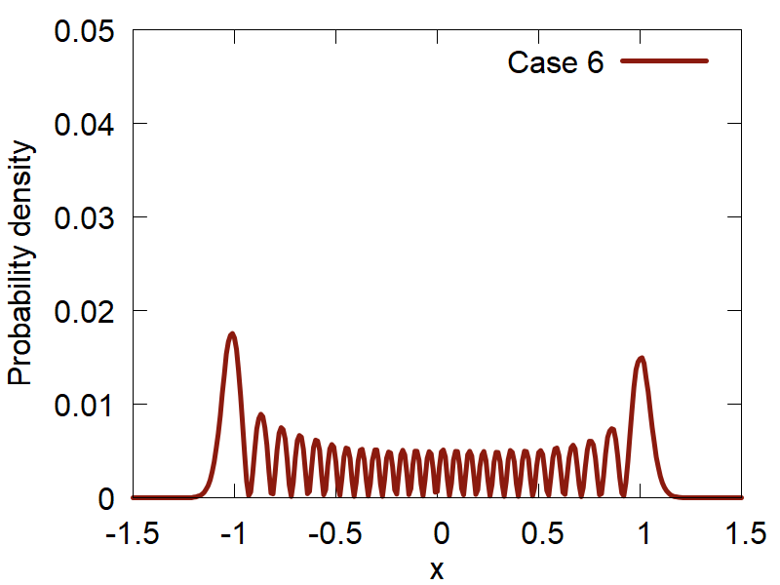
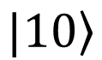
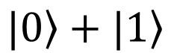
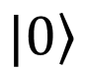
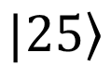
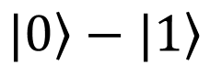
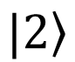
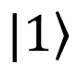
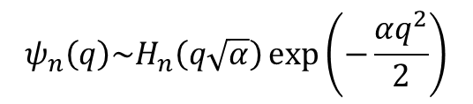
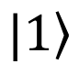
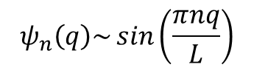
Initial conditions: Metropolis Sampling
Particle in a box
Harmonic oscillator
$$ψ_{n}\left(q\right)\sim \sin\left(\frac{πnq}{L}\right)$$
$$ψ_{n}\left(q\right)\sim H_{n}\left(q\sqrt{α}\right)\exp\left(−\frac{αq^{2}}{2}\right)$$
$$\left.|1\right\rangle$$
$$\left.|0\right\rangle$$
$$\left.|0\right\rangle +\left.|1\right\rangle$$
$$\left.|0\right\rangle −\left.|1\right\rangle$$
$$\left.|2\right\rangle$$
$$\left.|1\right\rangle$$
$$\left.|10\right\rangle$$
$$\left.|25\right\rangle$$

Slide 11
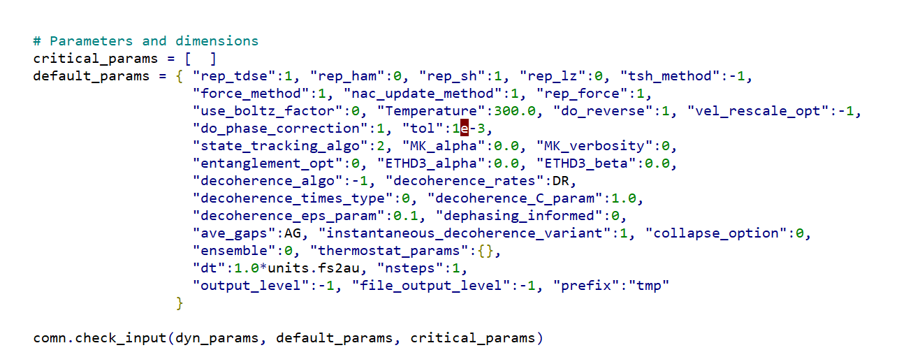
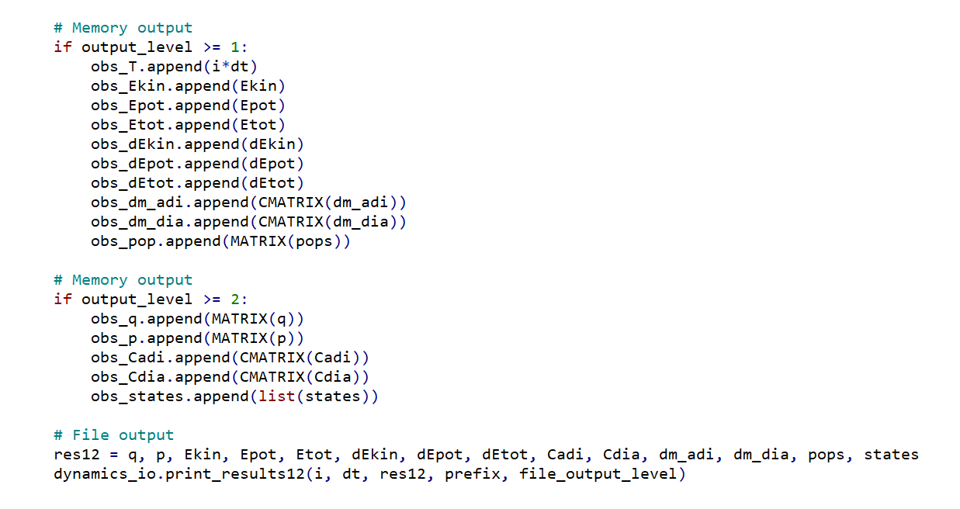
Some other ideas
Default & Critical Parameters
Type & Amount of Output

Slide 12


Acknowledgements
Funds:
Computing resources:
UB startup
OAC-NSF
Thank you! Questions?

